Slide 1
Endpoint Detection and Response (EDR) Extension
Suggested path forward.
01-20-2022

Slide 2
Restatement of Recommendation from last Update
Two parallel tracks
Continue to do what can be done with existing mapping approach
Has hard limits requiring additional parallel mechanisms
Enhanced by interacting with EDR systems, beyond just instrumented endpoints.
Can happen fast and needs a plan
Investigate the potential of leveraging existing models to extend the normalization of EDR/XDR consumption
More general enablement of normalized EDR consumption for more use cases
Requires analysis, debate and design
I’d like to lead or co-lead this effort

Slide 4
Update - Dennis
Suggestion 1: Make sure we design to interact with EDR systems, not solely with instrumented EDR endpoints
Strong contextual, detection, analysis, explain-ability and action consistency within an EDR system.
Working on how we extend (information architecture) to incorporate the EDR system view.
Suggestion 2: I believe that we need models to expand use cases significantly
Rationale follows…

Slide 5
EDR Normalization Challenge
Cloud, Console, Portfolio Integration…
EDR Core Value 1
Det Heuristics
ML Inf modules
ID
Tagging
Grouping
…
Consistent under 1 Vendor/Deployment, mutually opaque across Vendors/Deployments
EDR Agent (i)
Open Integration Subset
Registry
Files
ML Inf (n)
Hive
Shadow FS
Normalized at the interface to the OS abstractions

Slide 6
EDR/XDR Normalization Challenge 2
EDR Core Value 1
EDR Agent (i)
EDR Core Value 2
EDR(i) Cloud
Mining ML (i)
Orgs (grouping)
Risk Model (threshold)
Internal detection model
Registry
Files
ML Inf (n)
Hive
Shadow FS
EDR(i) Mgmt
…
EDR Core Value 1
IOCs
Auto
…
EDR Agent (i)
Registry
Files
ML Inf (n)
Hive
Shadow FS

Slide 7
EDR/XDR Normalization Challenge
Context, heuristics, ML training, ML inference, grouping, management topology… are effectively silo’d
Comparability, explain-ablility, and interpretability are only possible across consistent underlying attributes/relationships.
Hunting, analysis, planning, actions at scale … all need context that is not unifyable across vendors.
EDR Core Value 1
EDR Agent (i)
EDR Core Value 1
EDR Core Value 2
EDR(i) Cloud
EDR Agent (i)
EDR Core Value 1
EDR Core Value 2
EDR(i) Cloud
EDR Agent (i)
Mining ML (i)
Orgs (grouping)
Risk Model (threshold)
Internal detection model
EDR Core Value 2
EDR(i) Cloud
Mining ML (i)
Orgs (grouping)
Risk Model (threshold)
Internal detection model
Registry
Files
ML Inf (n)
Hive
Shadow FS
Mining ML (i)
Orgs (grouping)
Risk Model (threshold)
Internal detection model
Registry
Files
ML Inf (n)
EDR(i) Mgmt
…
Hive
Shadow FS
Registry
Files
ML Inf (n)
EDR(i) Mgmt
…
EDR Core Value 1
Hive
Shadow FS
IOCs
…
EDR(i) Mgmt
EDR Agent (i)
EDR Core Value 1
IOCs
EDR Agent (i)
EDR Core Value 1
IOCs …
EDR Agent (i)
Registry
Files
ML Inf (n)
Hive
Shadow FS
Registry
Files
ML Inf (n)
Hive
Shadow FS
Registry
Files
ML Inf (n)
*Communicating Indicators and Actions may be normalize-able, but may not be enough for effective EDR operation
EDR Commoditized Value 2
Hive
Shadow FS

Slide 8
Stix-Shifter: Highlights the limits of model-less normalization xEDRs
Trend
(XDR-ish)
STIX Object | STIX Property | Data Source Field
directory | path | objectFilePath
directory | path | processFilePath
directory | path | parentFilePath
directory | path | srcFilePath
domain-name | value | hostName
domain-name | value | objectHostName
domain-name | value | source_domain
email-addr | value | mail_message_sender
email-addr | value | mail_message_recipient
email-message | sender_ref | mail_message_sender
email-message | is_multipart | mail_message_sender
email-message | to_refs | mail_message_recipient
email-message | is_multipart | mail_message_recipient
email-message | subject | mail_message_subject
email-message | is_multipart | mail_message_subject
email-message | date | mail_message_delivery_time
email-message | is_multipart | mail_message_delivery_time
email-message | additional_header_fields | mail_internet_headers
file | hashes.SHA-1 | objectFileHashSha1
file | name | objectFilePath
file | parent_directory_ref | objectFilePath
file | hashes.SHA-1 | processFileHashSha1
file | name | processFilePath
file | parent_directory_ref | processFilePath
file | hashes.SHA-1 | parentFileHashSha1
file | name | parentFilePath
file | parent_directory_ref | parentFilePath
file | name | srcFilePath
file | parent_directory_ref | srcFilePath
file | hashes.SHA-1 | srcFileHashSha1
file | name | file_name
file | hashes.SHA-1 | file_sha1
ipv4-addr | value | src
ipv4-addr | value | dst
ipv4-addr | value | endpointIp
ipv4-addr | value | objectIp
ipv4-addr | value | objectIps
ipv4-addr | value | source_ip
ipv6-addr | value | src
ipv6-addr | value | dst
ipv6-addr | value | endpointIp
ipv6-addr | value | objectIps
ipv6-addr | value | source_ip
network-traffic | src_ref | src
network-traffic | protocols | src
network-traffic | src_port | spt
network-traffic | protocols | spt
network-traffic | dst_ref | dst
network-traffic | protocols | dst
network-traffic | dst_port | dpt
network-traffic | protocols | dpt
network-traffic | dst_ref | objectIp
network-traffic | protocols | objectIp
network-traffic | dst_port | objectPort
network-traffic | protocols | objectPort
network-traffic | src_ref | source_ip
network-traffic | protocols | source_ip
process | command_line | objectCmd
process | binary_ref | objectFileHashSha1
process | binary_ref | objectFilePath
process | command_line | processCmd
process | binary_ref | processFileHashSha1
process | binary_ref | processFilePath
process | command_line | parentCmd
process | binary_ref | parentFileHashSha1
process | binary_ref | parentFilePath
url | value | request
url | value | mail_urls
user-account | account_login | logonUser
user-account | user_id | objectUser
windows-registry-key | key | objectRegistryKeyHandle
windows-registry-key | values | objectRegistryValueType
CrowdStrike
STIX Object | STIX Property | Data Source Field
directory | path | filepath
domain-name | Value | domain_ioc
File | Name | filename
file | parent_directory_ref | filepath
file | hashes.SHA-256 | sha256
file | hashes.MD5 | md5
file | hashes.SHA-256 | parent_sha256
file | hashes.SHA-256 | sha256_ioc
file | hashes.SHA-256 | quarantined_file_sha256
file | hashes.MD5 | md5_ioc
file | hashes.MD5 | parent_md5
ipv4-addr | value | external_ip
ipv4-addr | value | local_ip
mac-addr | value | mac_address
network-traffic | dst_ref | domain_ioc
process | binary_ref | filename
process | name | filename
process | binary_ref | filepath
process | command_line | cmdline
process | creator_user_ref | user_name
process | creator_user_ref | user_id
process | binary_ref | parent_sha256
process | parent_ref | parent_sha256
process | pid | parent_process_graph_id
process | parent_ref | parent_process_graph_id
process | pid | triggering_process_graph_id
process | binary_ref | parent_md5
process | parent_ref | parent_md5
process | command_line | parent_cmdline
process | parent_ref | parent_cmdline
user-account | account_login | user_name
user-account | user_id | user_id
windows-registry-key | key | registry_key
x-crowdstrike | machine_domain | machine_domain
x-crowdstrike | device_id | device_id
x-crowdstrike | detection_id | detection_id
x-crowdstrike | scenario | scenario
x-crowdstrike | technique | technique
x-crowdstrike | tactic | tactic
x-crowdstrike | tactic_id | tactic_id
x-crowdstrike | technique_id | technique_id
x-crowdstrike | agent_local_time | agent_local_time
x-crowdstrike | agent_version | agent_version
x-crowdstrike | first_seen | first_seen
x-crowdstrike | last_seen | last_seen
x-crowdstrike | platform_id | platform_id
x-crowdstrike | confidence | confidence
x-crowdstrike | ioc_type | ioc_type
x-crowdstrike | ioc_value | ioc_value
x-crowdstrike | ioc_value | bios_manufacturer
x-crowdstrike | ioc_value | bios_version
x-crowdstrike | ioc_value | config_id_base
x-crowdstrike | ioc_value | config_id_build
x-crowdstrike | ioc_value | config_id_platform
x-crowdstrike | ioc_value | product_type
x-crowdstrike | ioc_value | product_type_desc
x-crowdstrike | ioc_value | site_name
x-crowdstrike | ioc_value | system_product_name
x-crowdstrike | ioc_value | modified_timestamp
x-oca-asset | ip_refs | external_ip
x-oca-asset | hostname | hostname
x-oca-asset | ip_refs | local_ip
x-oca-asset | mac_refs | mac_address
x-oca-asset | os_version | os_version
x-oca-asset | os_platform | platform_name
x-oca-event | created | timestamp
x-oca-event | process_ref | filename
x-oca-event | action | display_name
x-oca-event | outcome | description
x-oca-event | registry_ref | registry_key
x-oca-event | network_ref | domain_ioc
x-oca-event | file_ref | sha256_ioc
x-oca-event | file_ref | quarantined_file_sha256
x-oca-event | file_ref | md5_ioc
x-oca-event | parent_process_ref | parent_md5
x-oca-event | host_ref | hostname
x-oca-event | provider | provider
x-oca-event | severity | severity
CarbonBlack
Distributing IOCs , fielding simple alerts and taking simple action may work fine, if aimed at the EDR as a system ... and if Stix-Shifter mappings are expanded consistently.
Semantic inconsistencies that will interfere with xEDR sense making, decision support and action:
STIX Object | STIX Property | Data Source Field
directory | path | process_path
directory | path | parent_path
file | name | process_name
file | hashes.MD5 | process_md5
file | hashes.SHA-256 | process_sha256
file | parent_directory_ref | process_path
file | name | parent_name
file | hashes.MD5 | parent_md5
file | hashes.SHA-256 | parent_sha256
file | parent_directory_ref | parent_path
process | creator_user_ref | process_username
process | created | process_start_time
process | name | process_name
process | binary_ref | process_name
process | pid | process_pid
process | x_unique_id | process_guid
process | command_line | process_cmdline
process | name | parent_name
process | binary_ref | parent_name
process | parent_ref | parent_name
process | pid | parent_pid
process | x_unique_id | parent_guid
process | command_line | parent_cmdline
user-account | user_id | process_username
x-cbcloud | device_name | device_name
x-cbcloud | device_internal_ip | device_internal_ip
x-cbcloud | device_external_ip | device_external_ip
x-cbcloud | device_os | device_os
x-cbcloud | device_id | device_id
x-cbcloud | device_timestamp | device_timestamp
x-cbcloud | org_id | org_id
x-cbcloud | device_group_id | device_group_id
x-cbcloud | process_terminated | process_terminated
x-cbcloud | regmod_count | regmod_count
x-cbcloud | netconn_count | netconn_count
x-cbcloud | filemod_count | filemod_count
x-cbcloud | modload_count | modload_count
x-cbcloud | childproc_count | childproc_count
x-cbcloud | crossproc_count | crossproc_count
x-cbcloud | scriptload_count | scriptload_count
xEDR attrib relationships
xEDR attrib representations
Opaque unjoinable IDs
Normalizing the consumption of EDR capability, via the Stix-Shifter mapping approach won’t work, due to limitations in what products expose (attributes, reps, analytics, inf, train, …mgmt).
We need a model… probably two models
Ref. https://github.com/opencybersecurityalliance/stix-shifter/tree/develop/adapter-guide

Slide 9
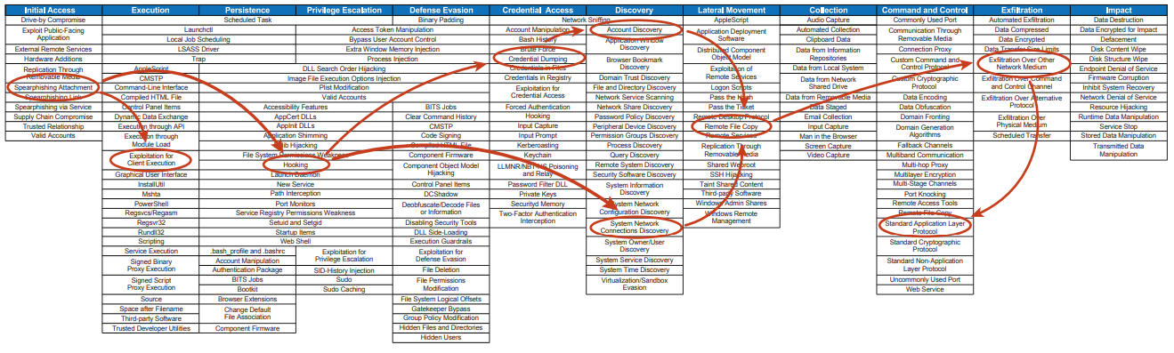
Malware behavior: invariant across EDR/XDRs (good normalization candidate)
Representative malware behavior and detection is only visible at the EDR/XDR system level. Not in endpoint telemetry.
Consider “action profile detection” vs “HMM detection” or “Kalman detection” … completely different (inconsistent) X EDRs
Ref: https://attack.mitre.org/docs/attack_roadmap_2020_october.pdf

Slide 10
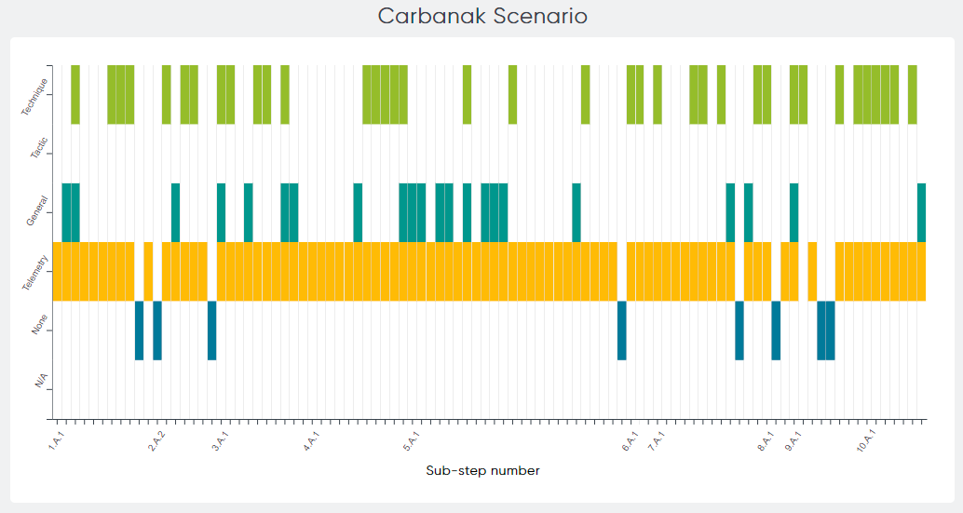
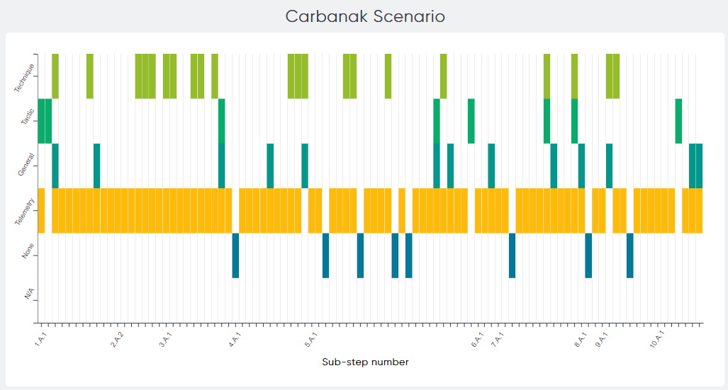
Different EDR/XDR tools observe, detect and respond very differently
Ref. https://attackevals.mitre-engenuity.org/enterprise/carbanak_fin7/
Carbon Black
No clear basis for interpretability, explain-ability or actionability across different EDR/XDR tools at the telemetry or detection (largely cloud based) level.
Normalizing at the TTP level (via mapping) makes these semantic and action discontinuities clear.
IOCs and “actions” mask these fundamental differences, for all but the simplest actions and indications. Supply Chain and Ransomware exploits are much more complex, and often with little or know prior knowledge when it matters most (during hunting, anomaly and behavioral recognition).
FireEye

Slide 11
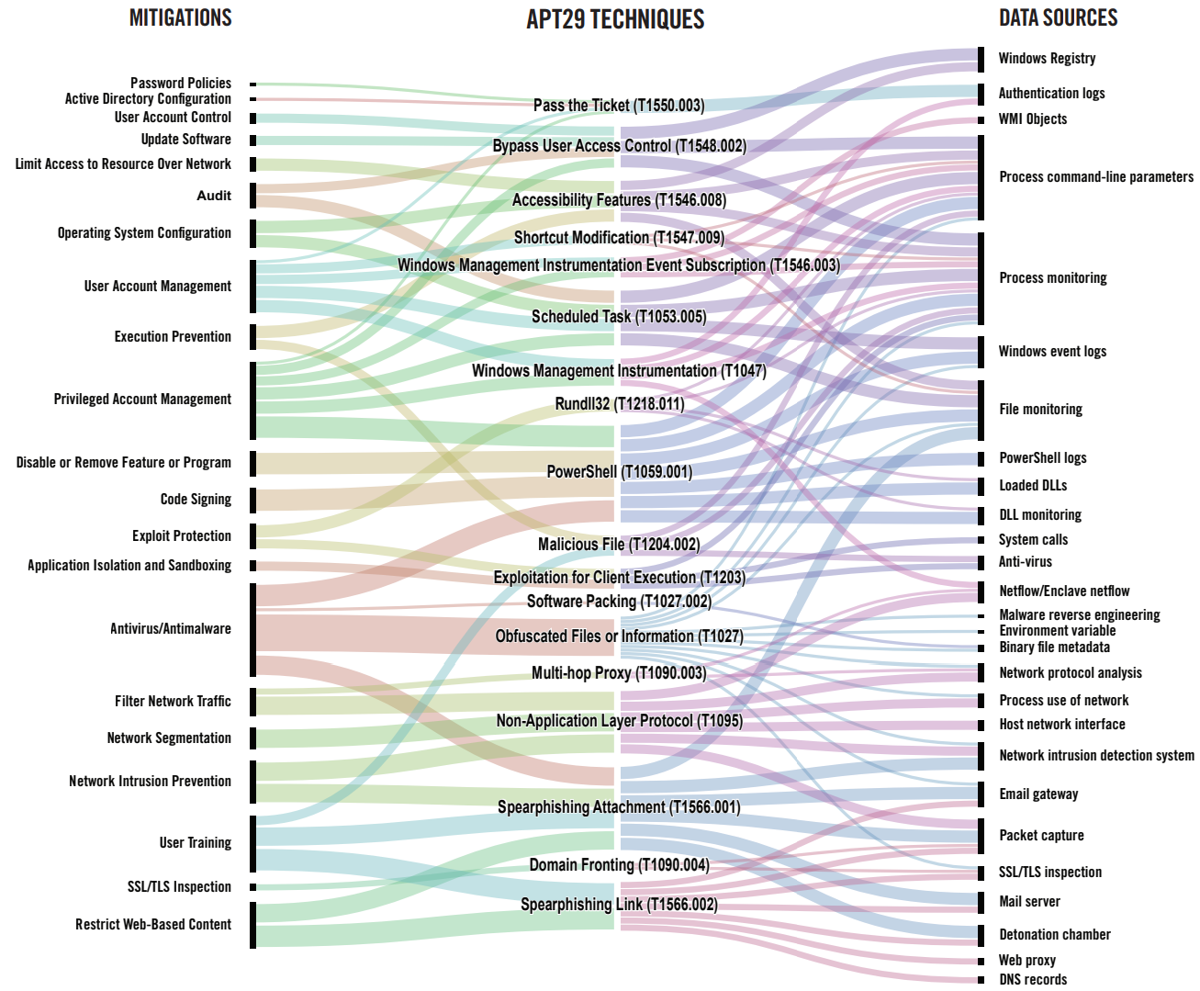
Needed to support EDR/XDR use cases (hunting, analysis mitigation planning, …)
Different EDR/XDR tools detect very differently
Different EDR/XDR tools use different basis set
Different EDR/XDR tools mitigate (act) differently
Ref: https://attack.mitre.org/docs/attack_roadmap_2020_october.pdf
* This is far less of a problem for detection and response over exactly 1 EDR/XDR solution per enterprise.

Slide 12
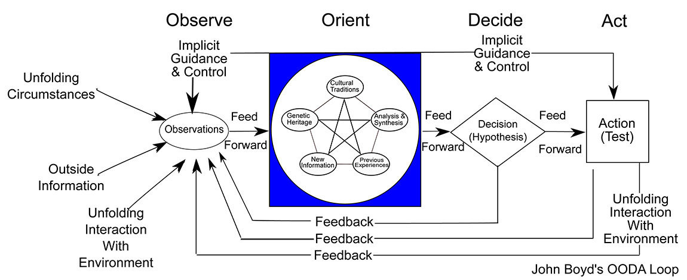
Inconsistencies across EDR/XDR break OODA; for a single EDR/XDR this is far less of a problem
Intention/Provisioning/Architecture
Model-Informed Orientation
(different in every EDR)
Correct action and feedback efficacy both depend on a working model
Telemetry/Intel
EDR IOCs and Telemetry
Ref. https://commons.wikimedia.org/wiki/File:OODA.Boyd.svg

Slide 13
Recommendation
Two parallel tracks
Continue to do what can be done with existing mapping approach
Has hard limits requiring additional parallel mechanisms
Enhanced by interacting with EDR systems, beyond just instrumented endpoints.
Can happen fast
Investigate the potential of leveraging existing models to extend the normalization of EDR/XDR consumption
More general enablement of normalized EDR consumption for more use cases
Requires analysis, debate and design
1. and 2. above are highly complementary, probably mutually necessary to cultivate sustainable communities of interest, and to influence the market.
So, I’d like to still proceed on the expanded analysis proposed in the last meeting

Slide 14
Previous work follows …

Slide 15
EDR Now
Mitre key EDR components
https://heimdalsecurity.com/blog/what-is-edr-endpoint-detection-and-response/
Endpoint data Collection
Data Analysis and Forensics
Threat Hunting – Chasing and resolving inconsistencies, indicators, outliers
Automated response to block malicious activity
Gartner primary EDR capabilities
https://www.gartner.com/reviews/market/endpoint-detection-and-response-solutions
Detect Security Incidents
Contain Incident at the endpoint
Investigate security incidents
Provide remediation guidance
File-based and file-less threats

Slide 16
*Forrester EDR -> XDR : From Adapt or Die: EDR is Dead, Forrester – Crowdstrike, PAN, Trend … April 28, 2021
In XDR the endpoint becomes the correlation anchor, across sensing modalities, business context, and security tooling – consolidating related alerts across its data lake into a single incident.
In XDR, all offerings support automated RCA (in EDR: Trend, Kaspersky). Extends detection to entire attack lifecycle.
In XDR, responses are analytics triggered workflows, adaptively triggering (risk or criteria) captive playbooks. Risk-based triggers, policy structure/logic and orchestration are offering specific and externally opaque.
In XDR, beyond endpoint telemetry, includes network, platform, user, device, … in one place. (for analysis, ML training, pivoting, …) . Hunting, causal analysis, mitigation planning, … are all more accessible without cobbling across tools.

Slide 17
*Current XDR design drivers
In modern attacks, coherent telemetry across all endpoints is necessary (workstations, servers, mobile devices, cloud assets, …)
Cloud hosted data lake, analytics, training require cloud hosting for elasticity and pervasive availability, despite enterprise compromise.
Many enterprise will augment with, or rely on MDR to gain security analyst, hunting, mitigation planning expertise.

Slide 18
EDR Tools Now - Open Source
*Wazuh – OSSEC ++
*OSSEC – LIDS (xEndpoint), MW & RK detection, Automatable Actions, FIM, Inventory
*TheHive Cortex - IP, URL, domain, hashes, files, containment integration
OSQuery – very generic host monitoring (configuration, performance , infrastructure health), + FIM, YARA (file artifacts) scanning, anomaly detection, process auditing, log settings, …
*GRR – YARA, APIs, search and collect : files, reg, procs, mem cap, CPU, network, context … all OSs, massive scale, full API, full cloud enablement/leveraging
MIG – logs, files, memory, network, auditing, vulnerability mgmt, … eroding forensics
Volatility – digital forensics & incident response, EDR ++ (forensic dimension)
Complementary Open Source (NDRish)
NESSUS –
SNORT –
Ethercap –
Infection Monkey – (Guardicore)
* Multi-endpoint enabled comparison, analytics, behavior, detection. Querying individual endpoints severely limits EDR utility for these OS EDR tools.

Slide 19
EDR Tools Now - Commercial
Gartner EPP MQ Leaders
Microsoft - Defender for Endpoint
Crowdstrike - Falcon
Trend Micro Apex One – XDR for Cloud (Cloud One)
SentinelOne - Singularity
McAfee – MVISION EDR
Sophos – Intercept-X
13 non-Leaders
Very different models, semantics, actions, integrations, positioning

Slide 20
But EDR queries, results and semantics are highly balkanized
Different EDR interaction models: Structured API model , Query, Analyzers (which the refer artifacts), inter-endpoint…
Different property/attribute/value naming and representations – not too bad at the OS, but diverges as synthetic artifacts get referenced
Semantics can be wildly different:
Different detection approaches have different SNR, meaning and mitigation contexts (nw detection of any anomaly only informs network mitigation; ep detection may not know about any nw mitigations (.g. virtual patching))
Virtual patching at an upstream firewall, is not comparable to actual patching of a discovered vulnerability.
Example: See STIX Shifter

Slide 21
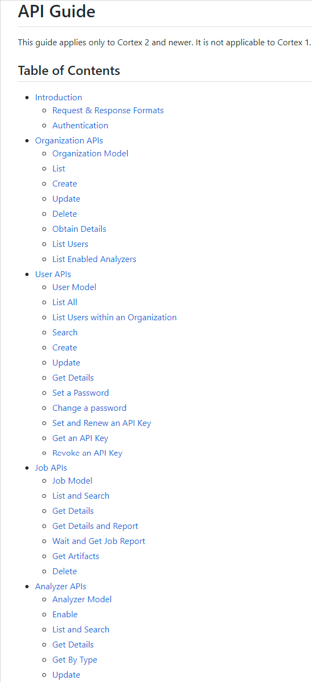
Example: Cortext 2
Cortex 2 API: https://github.com/TheHive-Project/CortexDocs/blob/master/api/api-guide.md#analyzer-model
Not artifact centric. Stimulate analyzers that the touch whatever observables they need to.
Heavily focused on the process of orchestrating EDR across roles and controlling access to the observables.
Enables analysis, detection and response across endpoints.
Many internally defined abstractions (orgs, users, jobs, analyzers, …). Conventional EDR is embedded.
There is a file analyzer.

Slide 22
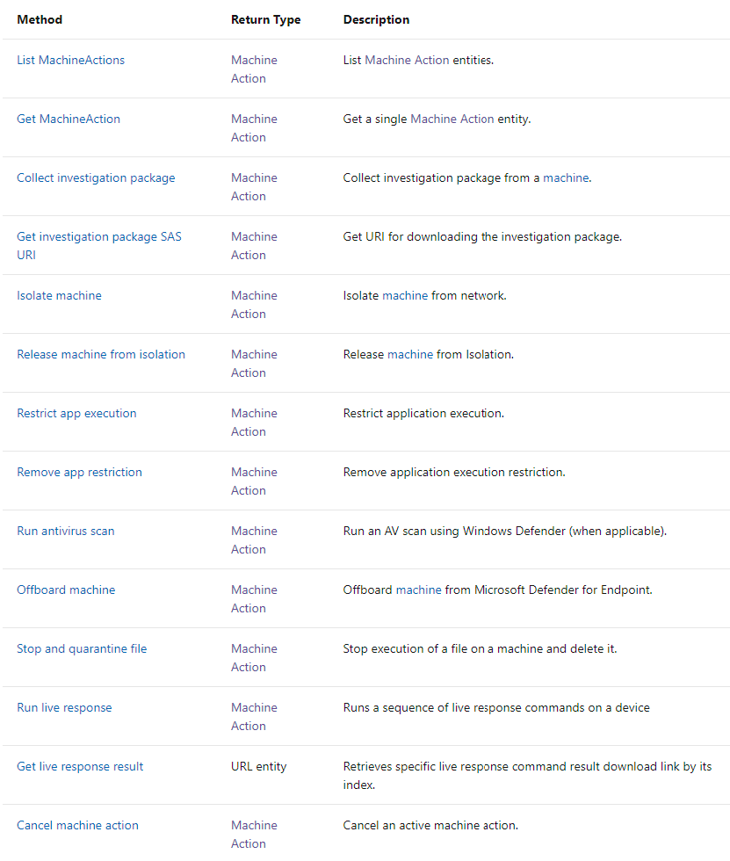
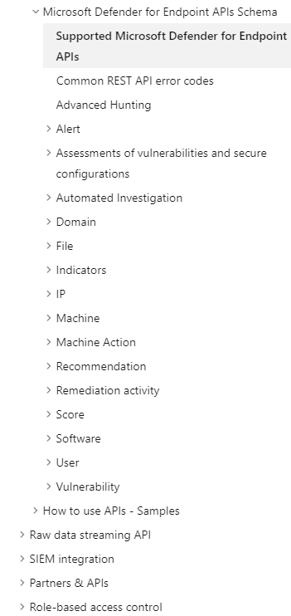
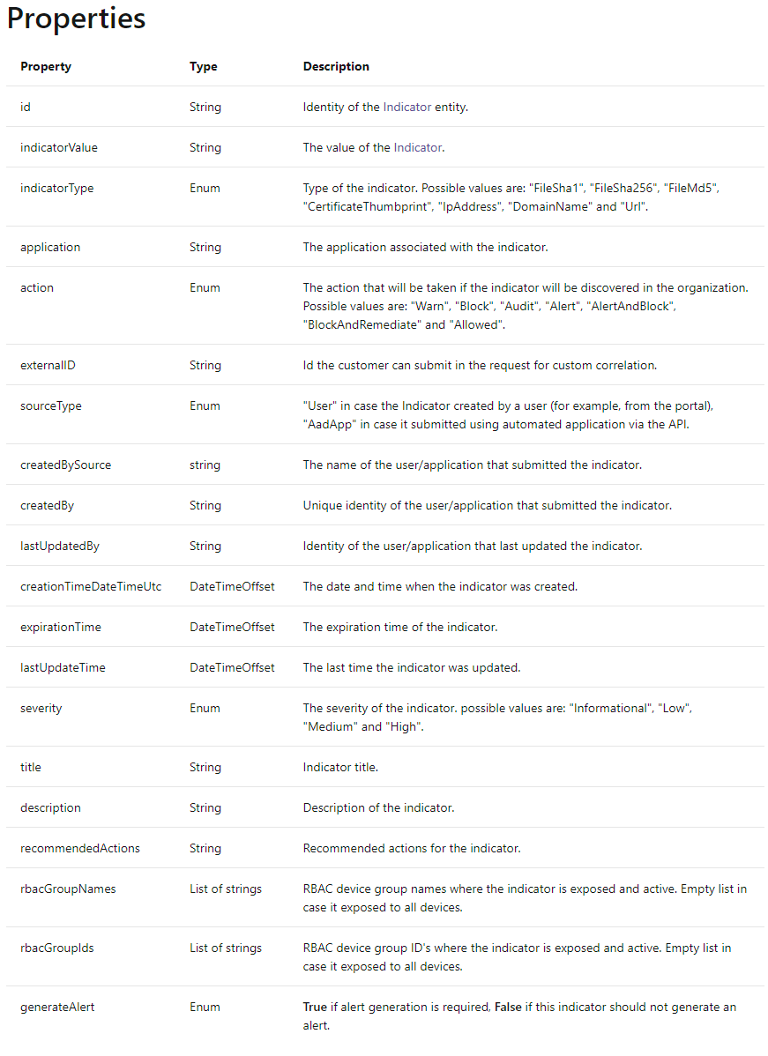
Example: Microsoft Defender for Endpoint
Defender for Endpoint API: https://docs.microsoft.com/en-us/microsoft-365/security/defender-endpoint/ti-indicator?view=o365-worldwide
Very artifact centric..
Unique abstractions (e.g. “investigation package”)
Deep integration of opaque analytics, correlation, policy driven actions.

Slide 23
EDR, NDR, XDR, and MDR are converging.
*Gartner labels the market for technology in this convergence EPP subsuming EDR.
Endpoint and network convergence is accelerating. All attacks exhibit both. Detect++
By 2032 YE, cloud delivered EPP will exceed 95% of deployments
By 2025 50% of EDR users will be using managed detection and response
By 2025 60% of EDR solutions will include data from multiple security control sources, such as Identity, CASB and DLP
Question: Do we address this rapidly consolidating EPP space, which includes EDR, NDR, XDR, MDR? Or focus on the evaporating conventional EDR space?
Concern: Directly interacting with endpoints, about files processes, hashes, simple indicators … does not seem to be the center of EDR-EPP detection or action.
*Gartner EPP MQ May 2021

Slide 24
OASIS OpenC2-ap-edr
openc2-ap-edr - Defining Actions, Targets, Specifiers and Options that are consistent with the version 1.0 of the OpenC2 Language Specification in the context of command and control of various endpoint detection and response technologies.
https://github.com/oasis-tcs/openc2-ap-edr
Q: How much of this scope, do we envision covering?
Q: If not all, how do we describe the subset we will cover?
Assumption: Schema extension must be a semantic and context cover of the scope we embrace.

Slide 25
Utility of Mitre ATT&CK is growing
Comparing EDR, NDR, XDR, MDR detection coverage
Bridging endpoint and network observed behaviors and state
Normalizing results (via mappings) across EDR, NDR, XDR, MDR offerings
Augmentation with Detection and Mitigation alternatives for same Procedure
TTPs across layers of abstraction:
Enterprise - OS, Cloud, Network, Container,
Mobile ,
ICS
…and across endpoints

Slide 26
Big Question
Question: Should we be integrating the schema at EDR system abstractions, rather than endpoint EDR instrumentation tool?
Would leverage higher level functionality.
Would leverage pre-existing policy orchestration and automation.
Would leverage real-time in-line controls.

Slide 27
Appendix

Slide 28
Suggestions
Make sure we design to interact with EDR systems, not solely with instrumented EDR endpoints
Strong contextual, detection, analysis, explain-ability and action consistency within an EDR system.
Working on how we extend (information architecture) to incorporate the EDR system view.

Slide 29
EDR Normalization Challenge
Cloud, Console, Portfolio Integration…
EDR Core Value 1
Det Heuristics
ML Inf modules
ID
Tagging
Grouping
…
Consistent under 1 Vendor/Deployment, mutually opaque across Vendors/Deployments
EDR Agent (i)
Open Integration Subset
Registry
Files
ML Inf (n)
Hive
Shadow FS
Normalized at the interface to the OS abstractions

Slide 30
EDR/XDR Normalization Challenge 2
EDR Core Value 1
EDR Agent (i)
EDR Core Value 2
EDR(i) Cloud
Mining ML (i)
Orgs (grouping)
Risk Model (threshold)
Internal detection model
Registry
Files
ML Inf (n)
Hive
Shadow FS
EDR(i) Mgmt
…
EDR Core Value 1
IOCs
Auto
…
EDR Agent (i)
Registry
Files
ML Inf (n)
Hive
Shadow FS

Slide 31
EDR/XDR Normalization Challenge
Context, heuristics, ML training, ML inference, grouping, management topology… are effectively silo’d
Comparability, explain-ablility, and interpretability are only possible across consistent underlying attributes/relationships.
Hunting, analysis, planning, actions at scale … all need context that is not unifyable across vendors.
EDR Core Value 1
EDR Agent (i)
EDR Core Value 1
EDR Core Value 2
EDR(i) Cloud
EDR Agent (i)
EDR Core Value 1
EDR Core Value 2
EDR(i) Cloud
EDR Agent (i)
Mining ML (i)
Orgs (grouping)
Risk Model (threshold)
Internal detection model
EDR Core Value 2
EDR(i) Cloud
Mining ML (i)
Orgs (grouping)
Risk Model (threshold)
Internal detection model
Registry
Files
ML Inf (n)
Hive
Shadow FS
Mining ML (i)
Orgs (grouping)
Risk Model (threshold)
Internal detection model
Registry
Files
ML Inf (n)
EDR(i) Mgmt
…
Hive
Shadow FS
Registry
Files
ML Inf (n)
EDR(i) Mgmt
…
EDR Core Value 1
Hive
Shadow FS
IOCs
…
EDR(i) Mgmt
EDR Agent (i)
EDR Core Value 1
IOCs
EDR Agent (i)
EDR Core Value 1
IOCs …
EDR Agent (i)
Registry
Files
ML Inf (n)
Hive
Shadow FS
Registry
Files
ML Inf (n)
Hive
Shadow FS
Registry
Files
ML Inf (n)
*Communicating Indicators and Actions may be normalize-able, but may not be enough for effective EDR operation
EDR Commoditized Value 2
Hive
Shadow FS

Slide 32
Stix-Shifter: Highlights the limits of model-less normalization xEDRs
Trend
(XDR-ish)
STIX Object | STIX Property | Data Source Field
directory | path | objectFilePath
directory | path | processFilePath
directory | path | parentFilePath
directory | path | srcFilePath
domain-name | value | hostName
domain-name | value | objectHostName
domain-name | value | source_domain
email-addr | value | mail_message_sender
email-addr | value | mail_message_recipient
email-message | sender_ref | mail_message_sender
email-message | is_multipart | mail_message_sender
email-message | to_refs | mail_message_recipient
email-message | is_multipart | mail_message_recipient
email-message | subject | mail_message_subject
email-message | is_multipart | mail_message_subject
email-message | date | mail_message_delivery_time
email-message | is_multipart | mail_message_delivery_time
email-message | additional_header_fields | mail_internet_headers
file | hashes.SHA-1 | objectFileHashSha1
file | name | objectFilePath
file | parent_directory_ref | objectFilePath
file | hashes.SHA-1 | processFileHashSha1
file | name | processFilePath
file | parent_directory_ref | processFilePath
file | hashes.SHA-1 | parentFileHashSha1
file | name | parentFilePath
file | parent_directory_ref | parentFilePath
file | name | srcFilePath
file | parent_directory_ref | srcFilePath
file | hashes.SHA-1 | srcFileHashSha1
file | name | file_name
file | hashes.SHA-1 | file_sha1
ipv4-addr | value | src
ipv4-addr | value | dst
ipv4-addr | value | endpointIp
ipv4-addr | value | objectIp
ipv4-addr | value | objectIps
ipv4-addr | value | source_ip
ipv6-addr | value | src
ipv6-addr | value | dst
ipv6-addr | value | endpointIp
ipv6-addr | value | objectIps
ipv6-addr | value | source_ip
network-traffic | src_ref | src
network-traffic | protocols | src
network-traffic | src_port | spt
network-traffic | protocols | spt
network-traffic | dst_ref | dst
network-traffic | protocols | dst
network-traffic | dst_port | dpt
network-traffic | protocols | dpt
network-traffic | dst_ref | objectIp
network-traffic | protocols | objectIp
network-traffic | dst_port | objectPort
network-traffic | protocols | objectPort
network-traffic | src_ref | source_ip
network-traffic | protocols | source_ip
process | command_line | objectCmd
process | binary_ref | objectFileHashSha1
process | binary_ref | objectFilePath
process | command_line | processCmd
process | binary_ref | processFileHashSha1
process | binary_ref | processFilePath
process | command_line | parentCmd
process | binary_ref | parentFileHashSha1
process | binary_ref | parentFilePath
url | value | request
url | value | mail_urls
user-account | account_login | logonUser
user-account | user_id | objectUser
windows-registry-key | key | objectRegistryKeyHandle
windows-registry-key | values | objectRegistryValueType
CrowdStrike
STIX Object | STIX Property | Data Source Field
directory | path | filepath
domain-name | Value | domain_ioc
File | Name | filename
file | parent_directory_ref | filepath
file | hashes.SHA-256 | sha256
file | hashes.MD5 | md5
file | hashes.SHA-256 | parent_sha256
file | hashes.SHA-256 | sha256_ioc
file | hashes.SHA-256 | quarantined_file_sha256
file | hashes.MD5 | md5_ioc
file | hashes.MD5 | parent_md5
ipv4-addr | value | external_ip
ipv4-addr | value | local_ip
mac-addr | value | mac_address
network-traffic | dst_ref | domain_ioc
process | binary_ref | filename
process | name | filename
process | binary_ref | filepath
process | command_line | cmdline
process | creator_user_ref | user_name
process | creator_user_ref | user_id
process | binary_ref | parent_sha256
process | parent_ref | parent_sha256
process | pid | parent_process_graph_id
process | parent_ref | parent_process_graph_id
process | pid | triggering_process_graph_id
process | binary_ref | parent_md5
process | parent_ref | parent_md5
process | command_line | parent_cmdline
process | parent_ref | parent_cmdline
user-account | account_login | user_name
user-account | user_id | user_id
windows-registry-key | key | registry_key
x-crowdstrike | machine_domain | machine_domain
x-crowdstrike | device_id | device_id
x-crowdstrike | detection_id | detection_id
x-crowdstrike | scenario | scenario
x-crowdstrike | technique | technique
x-crowdstrike | tactic | tactic
x-crowdstrike | tactic_id | tactic_id
x-crowdstrike | technique_id | technique_id
x-crowdstrike | agent_local_time | agent_local_time
x-crowdstrike | agent_version | agent_version
x-crowdstrike | first_seen | first_seen
x-crowdstrike | last_seen | last_seen
x-crowdstrike | platform_id | platform_id
x-crowdstrike | confidence | confidence
x-crowdstrike | ioc_type | ioc_type
x-crowdstrike | ioc_value | ioc_value
x-crowdstrike | ioc_value | bios_manufacturer
x-crowdstrike | ioc_value | bios_version
x-crowdstrike | ioc_value | config_id_base
x-crowdstrike | ioc_value | config_id_build
x-crowdstrike | ioc_value | config_id_platform
x-crowdstrike | ioc_value | product_type
x-crowdstrike | ioc_value | product_type_desc
x-crowdstrike | ioc_value | site_name
x-crowdstrike | ioc_value | system_product_name
x-crowdstrike | ioc_value | modified_timestamp
x-oca-asset | ip_refs | external_ip
x-oca-asset | hostname | hostname
x-oca-asset | ip_refs | local_ip
x-oca-asset | mac_refs | mac_address
x-oca-asset | os_version | os_version
x-oca-asset | os_platform | platform_name
x-oca-event | created | timestamp
x-oca-event | process_ref | filename
x-oca-event | action | display_name
x-oca-event | outcome | description
x-oca-event | registry_ref | registry_key
x-oca-event | network_ref | domain_ioc
x-oca-event | file_ref | sha256_ioc
x-oca-event | file_ref | quarantined_file_sha256
x-oca-event | file_ref | md5_ioc
x-oca-event | parent_process_ref | parent_md5
x-oca-event | host_ref | hostname
x-oca-event | provider | provider
x-oca-event | severity | severity
CarbonBlack
Distributing IOCs , fielding simple alerts and taking simple action may work fine, if aimed at the EDR as a system ... and if Stix-Shifter mappings are expanded consistently.
Semantic inconsistencies that will interfere with xEDR sense making, decision support and action:
STIX Object | STIX Property | Data Source Field
directory | path | process_path
directory | path | parent_path
file | name | process_name
file | hashes.MD5 | process_md5
file | hashes.SHA-256 | process_sha256
file | parent_directory_ref | process_path
file | name | parent_name
file | hashes.MD5 | parent_md5
file | hashes.SHA-256 | parent_sha256
file | parent_directory_ref | parent_path
process | creator_user_ref | process_username
process | created | process_start_time
process | name | process_name
process | binary_ref | process_name
process | pid | process_pid
process | x_unique_id | process_guid
process | command_line | process_cmdline
process | name | parent_name
process | binary_ref | parent_name
process | parent_ref | parent_name
process | pid | parent_pid
process | x_unique_id | parent_guid
process | command_line | parent_cmdline
user-account | user_id | process_username
x-cbcloud | device_name | device_name
x-cbcloud | device_internal_ip | device_internal_ip
x-cbcloud | device_external_ip | device_external_ip
x-cbcloud | device_os | device_os
x-cbcloud | device_id | device_id
x-cbcloud | device_timestamp | device_timestamp
x-cbcloud | org_id | org_id
x-cbcloud | device_group_id | device_group_id
x-cbcloud | process_terminated | process_terminated
x-cbcloud | regmod_count | regmod_count
x-cbcloud | netconn_count | netconn_count
x-cbcloud | filemod_count | filemod_count
x-cbcloud | modload_count | modload_count
x-cbcloud | childproc_count | childproc_count
x-cbcloud | crossproc_count | crossproc_count
x-cbcloud | scriptload_count | scriptload_count
xEDR attrib relationships
xEDR attrib representations
Opaque unjoinable IDs
Normalizing the consumption of EDR capability, via the Stix-Shifter mapping approach won’t work, due to limitations in what products expose (attributes, reps, analytics, inf, train, …mgmt).
We need a model… probably two models

Slide 33
Inconsistencies across EDR/XDR break OODA
Intention/Provisioning/Architecture
Model-Informed Orientation
(different in every EDR)
Correct action and feedback efficacy both depend on a working model
Telemetry/Intel
EDR IOCs and Telemetry

Slide 34
Recommendation
Two parallel tracks
Continue to do what can be done with existing mapping approach
Has hard limits requiring additional parallel mechanisms
Enhanced by interacting with EDR systems, beyond just instrumented endpoints.
Can happen fast
Investigate the potential of leveraging existing models to extend the normalization of EDR/XDR consumption
More general enablement of normalized EDR consumption for more use cases
Requires analysis, debate and design
1. and 2. above are highly complementary, probably mutually necessary to cultivate sustainable communities of interest, and to influence the market.
So, I’d like to still proceed on the expanded analysis proposed in the last meeting

Slide 35
EDR Normalization Objectives Expressed in PACE Meeting
Normalizing Response to EDR Detections (detection and action) across uniform deployments of any EDR
Possible with OpenC2, but actionable context will need to communicated using another or additional functionality.
May require talking to EDR systems (managers)
Normalizing Response to EDR Detections (detection and action) across heterogeneous deployments of arbitrary EDRs
Far harder, due to balkanized/fragmented and inconsistent model, analytics, ML, tagging, grouping, system topology, data domains (training) …
Certainly requires talking to managers.
Liberating the market from the walled gardens of proprietary EDR
Requires models of Telemetry, Mal behavior and Mitigation options

